Slide 1
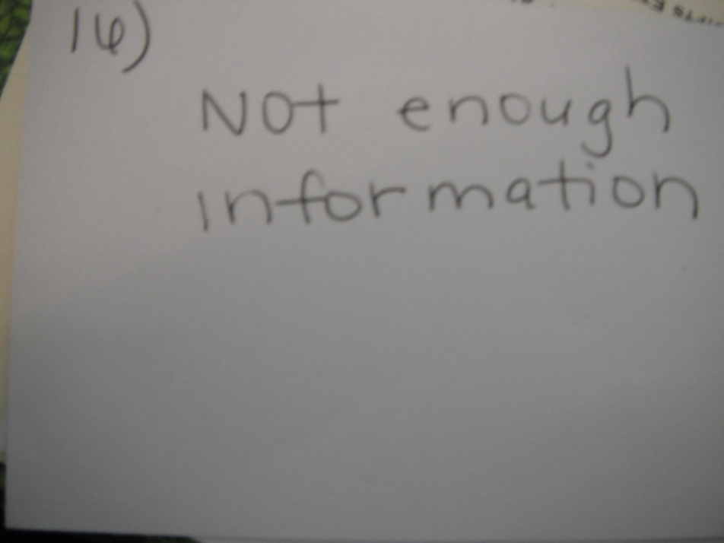
16. Find the value of x.
x○
170○

Slide 2
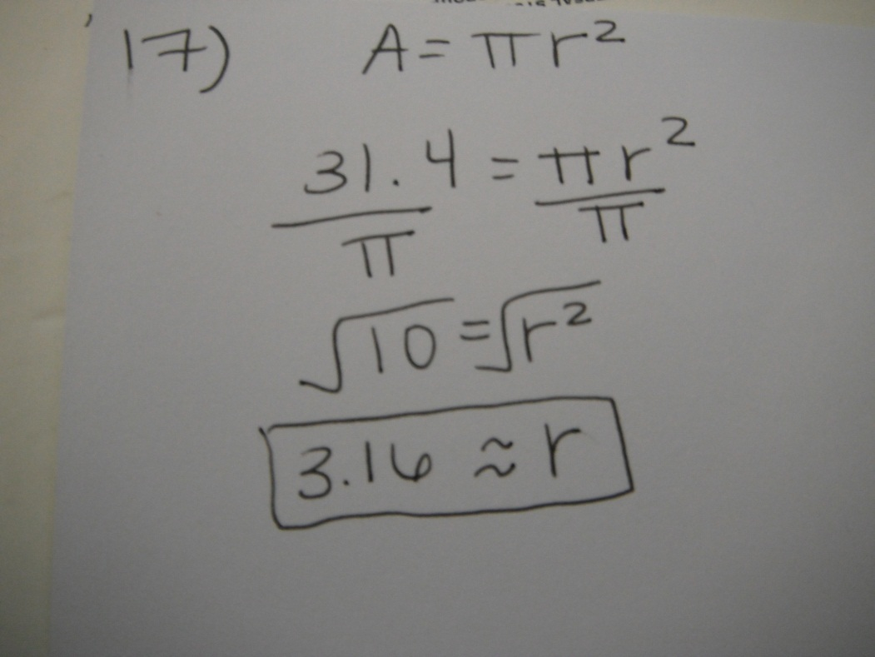
17. The area of a circle is 31.4 cm². What is the radius?

Slide 3
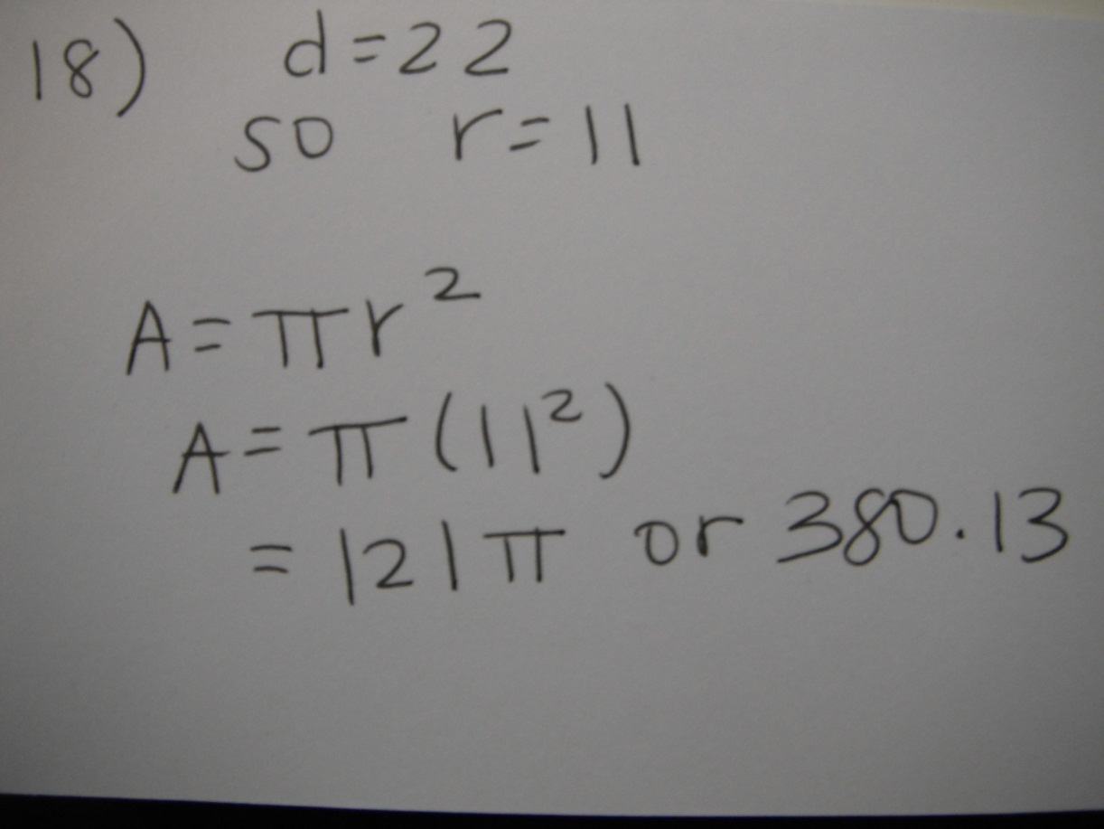
18. Find the area of a circle with a diameter of 22 inches.

Slide 4
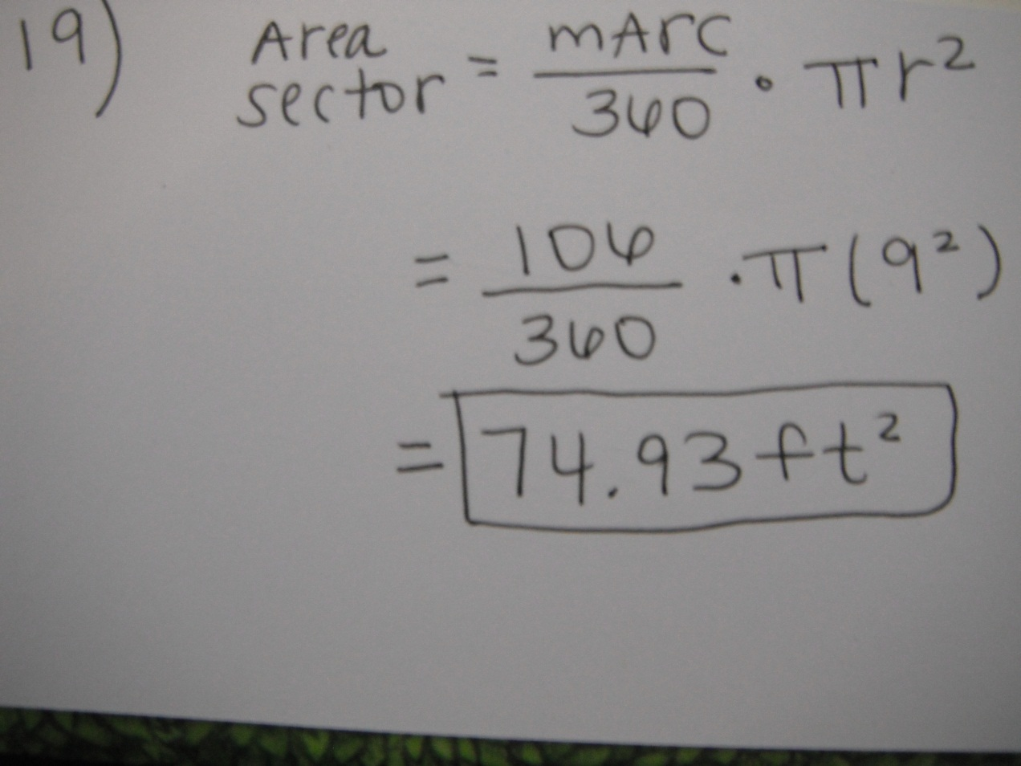
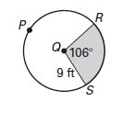
19. Find the area of the shaded region

Slide 5
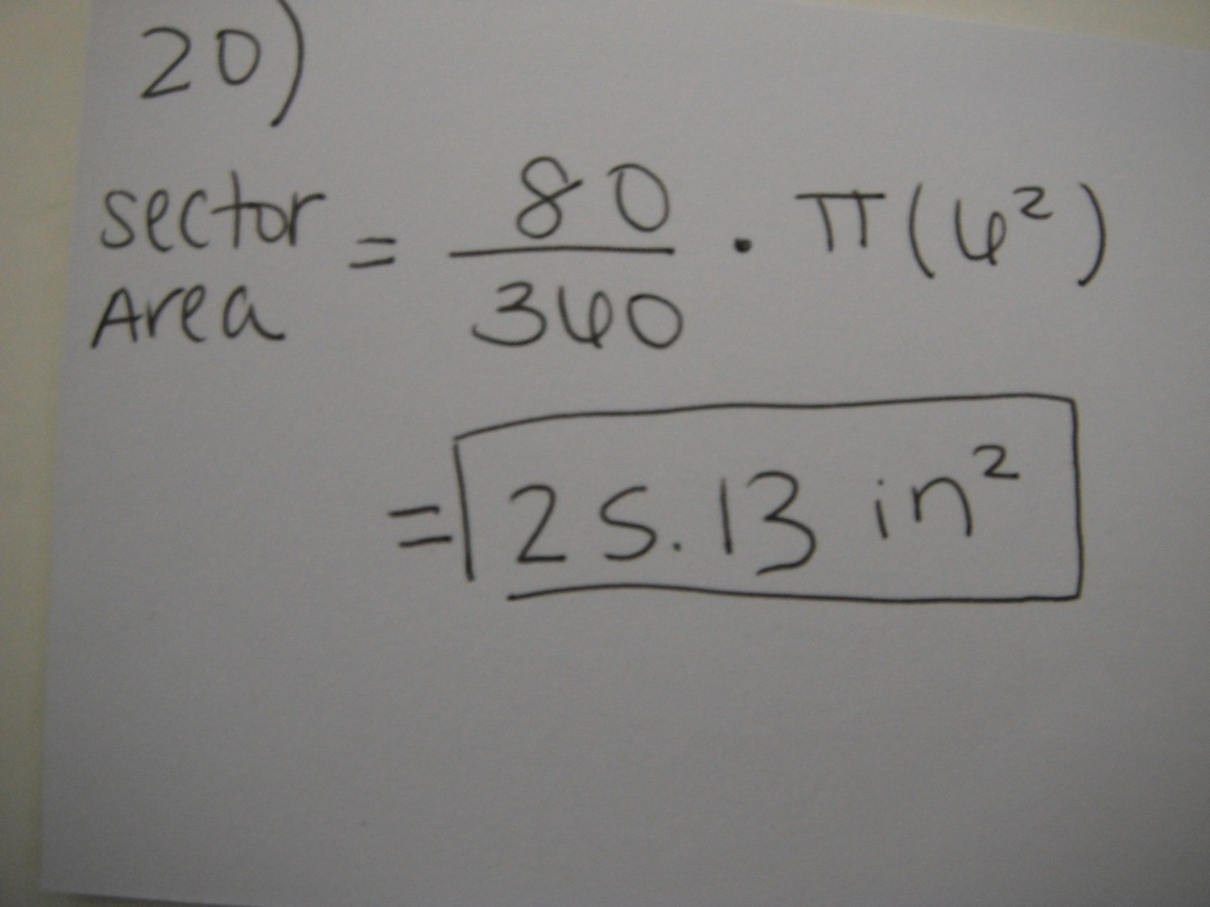
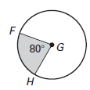
20. Find the area of the shaded region.

Slide 6
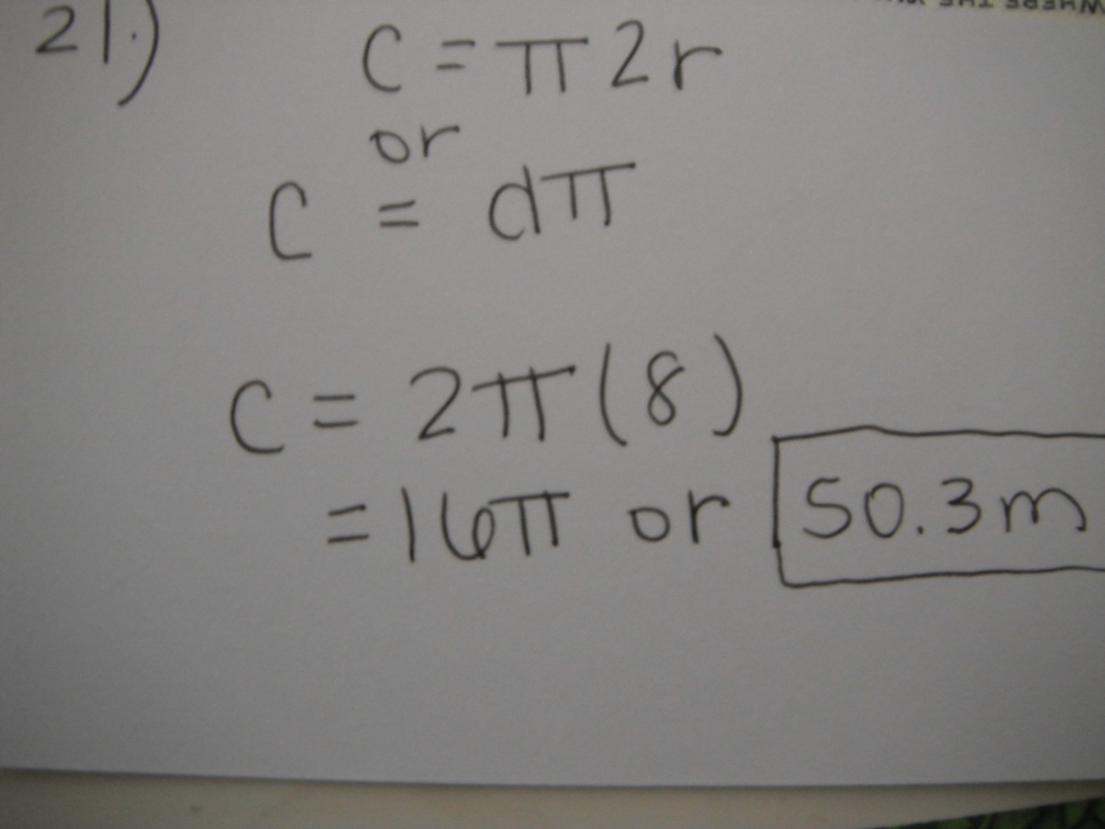
21. Find the circumference of a circle with a radius of 8 m.

Slide 7
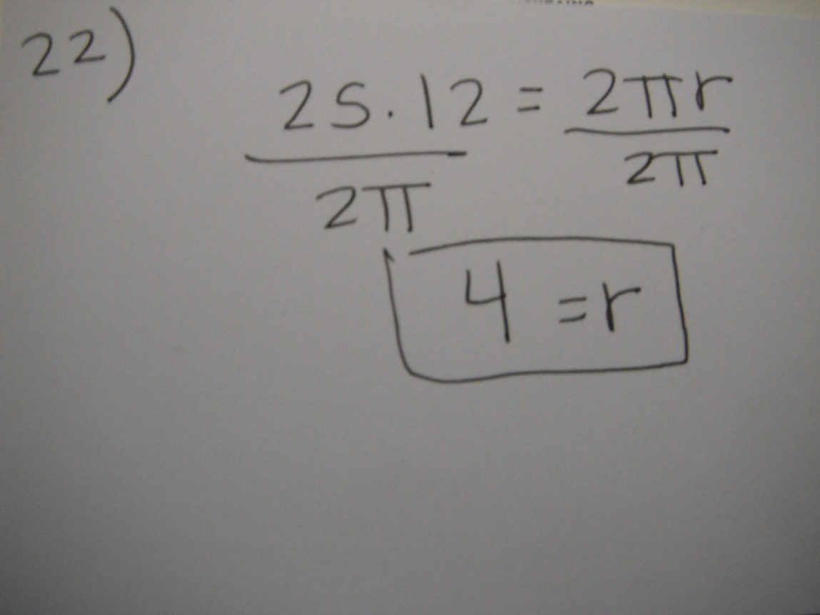
22. The circumference of a circle is 25.12 ft. What is the radius?

Slide 8
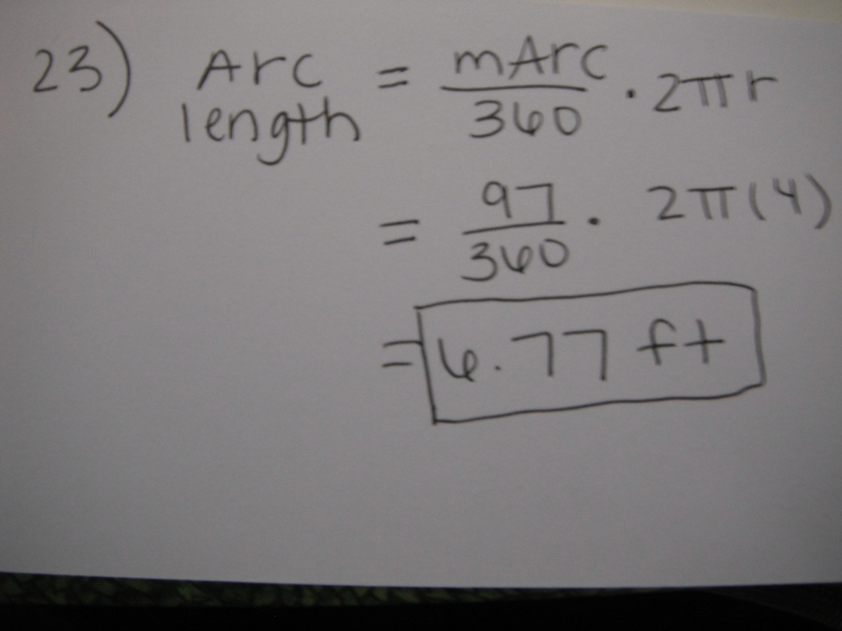
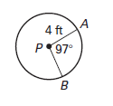
23. Find the arc length of

Slide 9
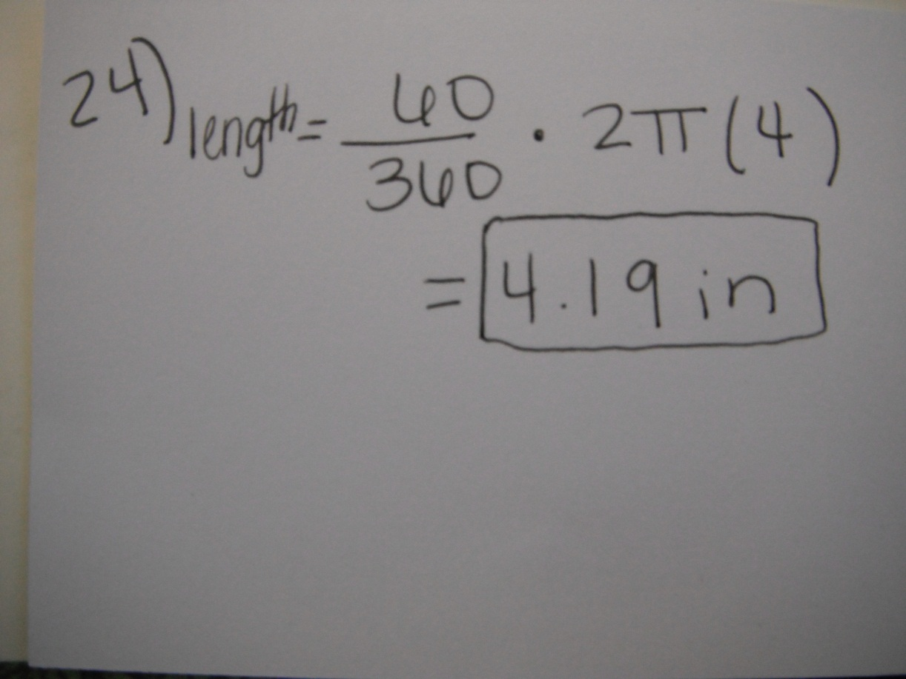
24. Find the arc length of

Slide 10
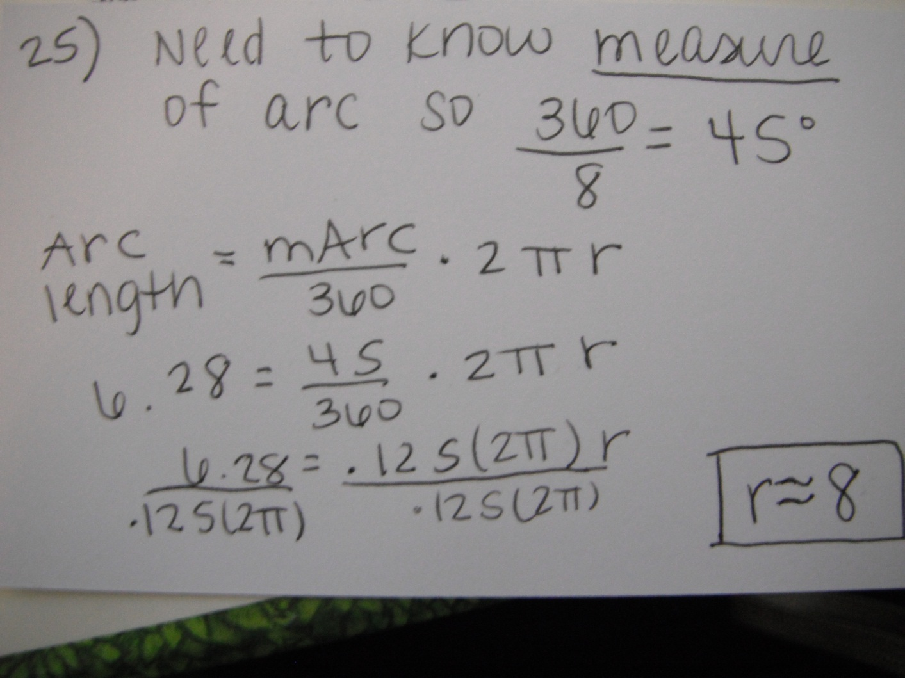
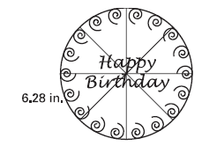
25. A birthday cake is sliced into 8 equal pieces. The arc length of one piece of cake is 6.28 inches, as shown. Find the diameter of the cake

Slide 11
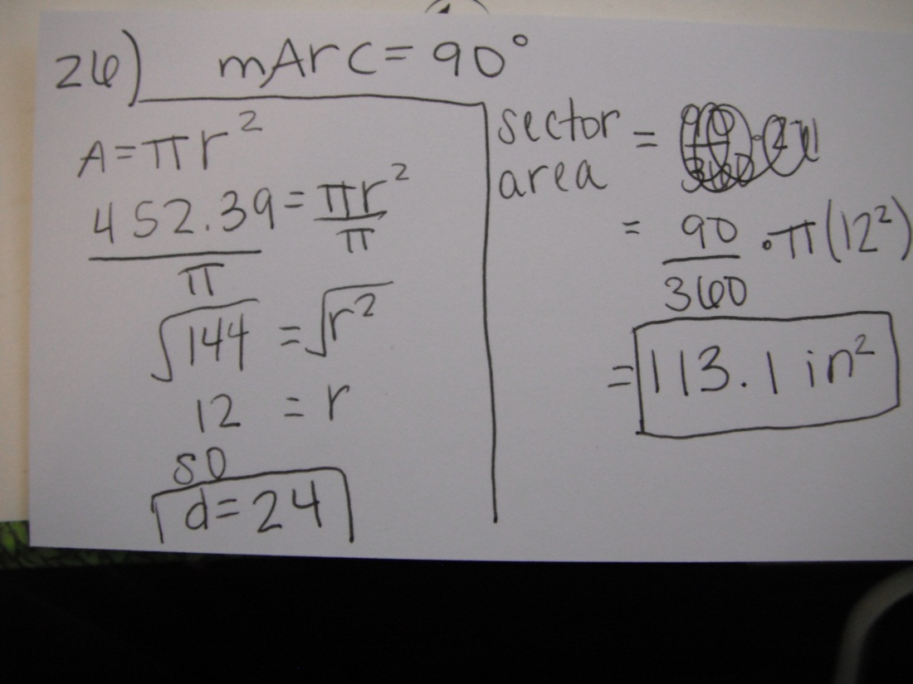
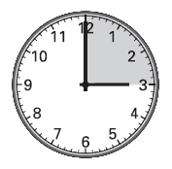
26. A wall clock has an area of 452.39 in². Find the diameter of the clock. Then find the area of the sector formed when the time is 3:00.

